Slide 1
San Diego Burrito Tourism Authority 2020 regional analysis
Project 2 | UCSD Data Science & Visualization Bootcamp
Prepared by:
Jason Gabunilas
Zhyi Li
Matthew Hutcherson
Elisa Gipe

Slide 2
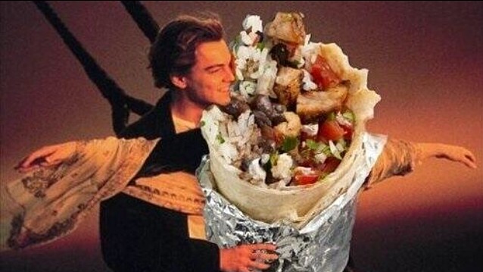
Project Methodology
Data Sets:
AirBnB listings in San Diego
Aggregate of Ratings from Blind Taste Testers (inclusive of Yelp and Google Reviews) found on Kaggle
Activity:
ETL (using Pythons- Pandas)
Created SQLite DB & Initialized tables
Created engine connection to DB and reflected tables (Flask)
Set up multiple routes for each pandas dataframe, each route creating JSON response for respective data
Used MapBox to create map and AirBNB Listing Overlays
Used D3 to call the data
Used Plotly and various libraries to create visualization
End Product:
Comparative Analysis between AirBNB Listings & Burrito Locations/Ratings
Map of AirBNB Listings (Overlay of all listings organized by Price)
Various charts to analyze the data sets

Slide 3
What went well, what didn’t
WINS
Pandas/ETL
JS Libraries
Map Overlays grouped by Price
OBSTACLES
JSON construct
Flask (remembering what it was..)
Burrito Data Set was sparsely populated and subjective
Map loading with 12K Listings

Slide 4

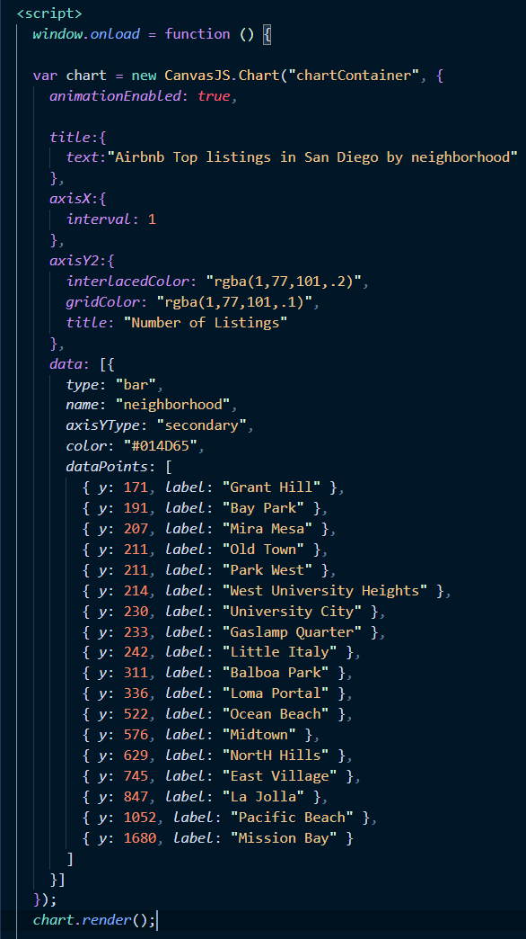
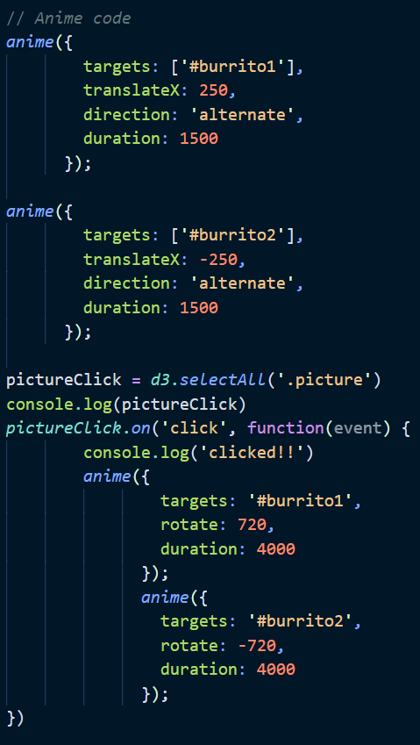
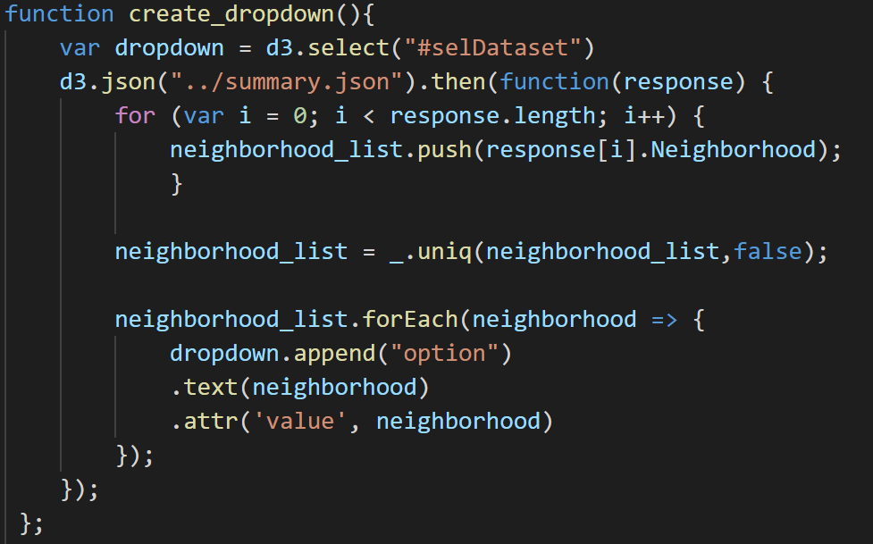
Javascript libraries
D3
Plotly
Leaflet JS
AnimeJS
Creates custom animations for HTML objects
CanvasJS
Visualization tool for charts and responsive dashboards
Underscore.JS
Library of pre-built functions to help
with efficiency

